Slide 1
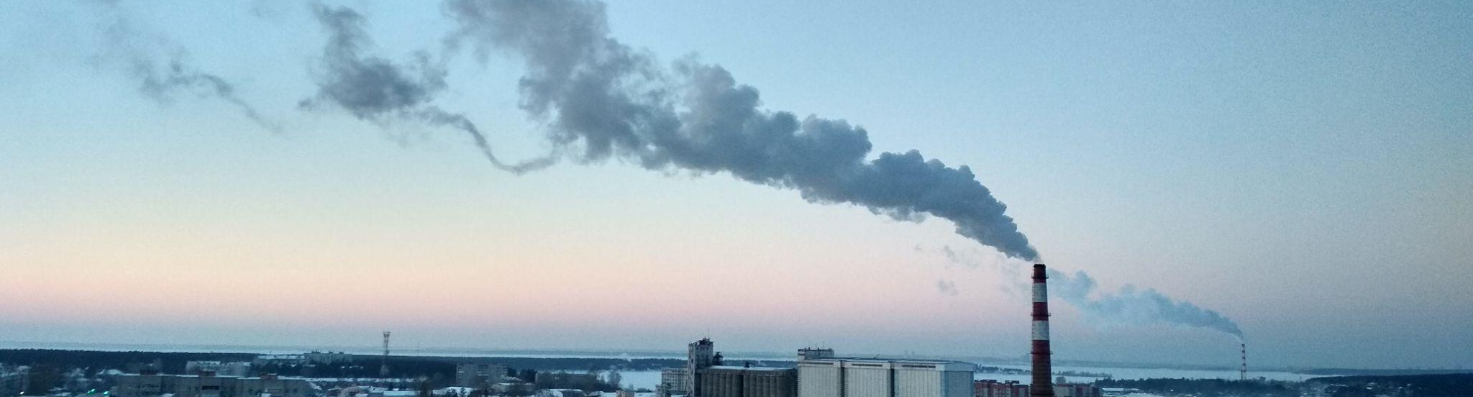



Vartalaap: What Drives #AirQuality Discussions: Politics, Pollution or Pseudo-science?
Rishiraj Adhikary, Zeel B Patel, Tanmay Srivastava, Nipun Batra, Mayank Singh, Udit Bhatia and Sarath Guttikunda#
Indian Institute of Technology (IIT)
Gandhinagar, Gujarat, India
#UrbanEmission.Info
New Delhi, India

Slide 2
In 2019 alone, air pollution was responsible for 1.67M deaths in India (17.8% of total deaths).*
*Health and economic impact of air pollution in the states of India: the Global Burden of Disease Study 2019: Pandey et al.
Vartalaap: What Drives #AirQuality Discussions: Politics, Pollution or Pseudo-science?

Slide 3
In 2019 alone, air pollution was responsible for 1.67M deaths in India (17.8% of total deaths)
Ambient fine particulate (PM_{2.5}) is the most significant risk factor for premature death, shortening life expectancy at birth by 1.5 to 1.9 years.*
*Ambient PM2. 5 reduces global and regional life expectancy. Environmental Science & Technology Letters: Apte et al.
Vartalaap: What Drives #AirQuality Discussions: Politics, Pollution or Pseudo-science?

Slide 4
Adverse Health Effects
*Short-term exposures (up to 24-hours duration) have been associated with,
Premature mortality
Increased hospital admissions for heart or lung causes,
Acute and chronic bronchitis,
Asthma attacks,
Emergency room visits,
Respiratory symptoms, and
Restricted activity days
*Global Burden of Disease Project.
Vartalaap: What Drives #AirQuality Discussions: Politics, Pollution or Pseudo-science?

Slide 5
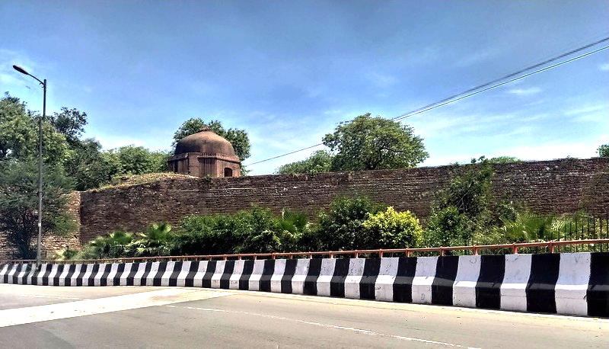
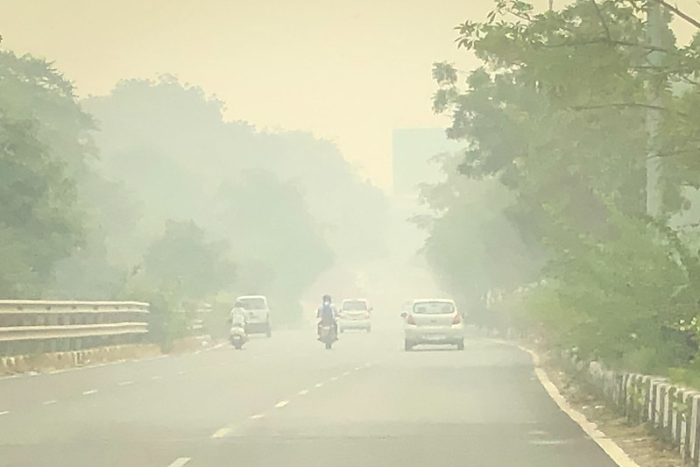
Which place is more polluted ?
A
B
Vartalaap: What Drives #AirQuality Discussions: Politics, Pollution or Pseudo-science?

Slide 6
While B is more polluted. Pollution level in A is 6 times above the WHO limit!
PM_{2.5}: 92 μg/m³
PM_{2.5}: 256 μg/m³
A
B
Vartalaap: What Drives #AirQuality Discussions: Politics, Pollution or Pseudo-science?

Slide 7
While B is more polluted. Pollution level in A is 6 times above the WHO limit!
PM_{2.5}: 92 μg/m³
PM_{2.5}: 256 μg/m³
According to WHO, daily mean PM_{2.5} should not be more than 15 μg/m³.
Vartalaap: What Drives #AirQuality Discussions: Politics, Pollution or Pseudo-science?

Slide 8
Air pollution is not always visible, leading to incorrect perception.
PM_{2.5}: 92 ug/m³
Vartalaap: What Drives #AirQuality Discussions: Politics, Pollution or Pseudo-science?

Slide 9
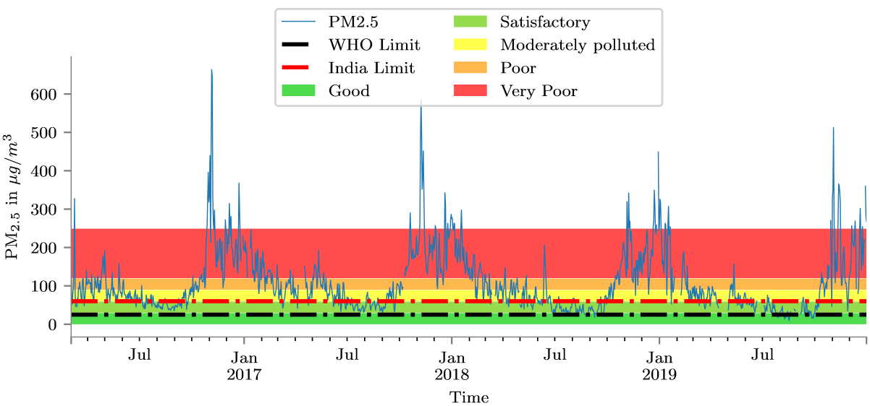
Air quality in Delhi (India) is a year long problem
Vartalaap: What Drives #AirQuality Discussions: Politics, Pollution or Pseudo-science?

Slide 10

Research Questions
What is the public perception towards air pollution mitigation strategies?
Vartalaap: What Drives #AirQuality Discussions: Politics, Pollution or Pseudo-science?

Slide 11

Research Questions
What is the public perception towards air pollution mitigation strategies?
Does air pollution cause Twitter discussion?
Vartalaap: What Drives #AirQuality Discussions: Politics, Pollution or Pseudo-science?

Slide 12

Research Questions
What is the public sentiment towards mitigation strategies?
Does air pollution cause twitter discussion?
What are the air pollution topics discussed on social media?
Vartalaap: What Drives #AirQuality Discussions: Politics, Pollution or Pseudo-science?

Slide 13
Related Work
Questionnaire based surveys for perception studies are not scalable and do not account for temporal reaction changes.
Vartalaap: What Drives #AirQuality Discussions: Politics, Pollution or Pseudo-science?

Slide 14
Related Work
Questionnaire based surveys for perception studies are not scalable and do not account for temporal reaction changes.
Social media has been used for sentiment analysis on climate change data and air quality. But, air quality studies are on smaller dataset and shorter period.
Vartalaap: What Drives #AirQuality Discussions: Politics, Pollution or Pseudo-science?

Slide 15
Approach Intuition
Our approach is to leverage the advances in NLP and statistics to use social media for gauging public perception.
Vartalaap: What Drives #AirQuality Discussions: Politics, Pollution or Pseudo-science?

Slide 16
Dataset
We use Twitter to curate a dataset of 1.2 Million tweets which talk about Delhi air pollution between January 2016 to March 2020.
Vartalaap: What Drives #AirQuality Discussions: Politics, Pollution or Pseudo-science?

Slide 17
Dataset
We use Twitter to curate a dataset of 1.2 Million tweets which talk about Delhi air pollution between January 2016 to March 2020.
We used query based and hashtag based snowball sampling approach to retrieve the tweets.
Vartalaap: What Drives #AirQuality Discussions: Politics, Pollution or Pseudo-science?

Slide 18
Dataset
We use Twitter to curate a dataset of 1.2 Million tweets which talk about Delhi air pollution between January 2016 to March 2020.
We used query based and hashtag based snowball sampling approach to retrieve the tweets.
#DelhiAgainstPollution, delhi pollution, #DelhiPollution, #SmogTower, #DelhiAir, #DelhiAirEmergency, #DelhiChokes, #DelhiAirQuality, #DelhiSmog, #OddEven, #DelhiFog
Vartalaap: What Drives #AirQuality Discussions: Politics, Pollution or Pseudo-science?

Slide 19
Dataset
Twitter Data | Time Period | Jan’16 to Apr’20
 | Total Tweets | 1.2 Million
 | Total Queries | 34
Air Pollution Data (PM_{2.5}) | Time Period | Jan’16 to Dec’19
 | Location | 13
 | Granularity Level | 1 Hour
Vartalaap: What Drives #AirQuality Discussions: Politics, Pollution or Pseudo-science?

Slide 20
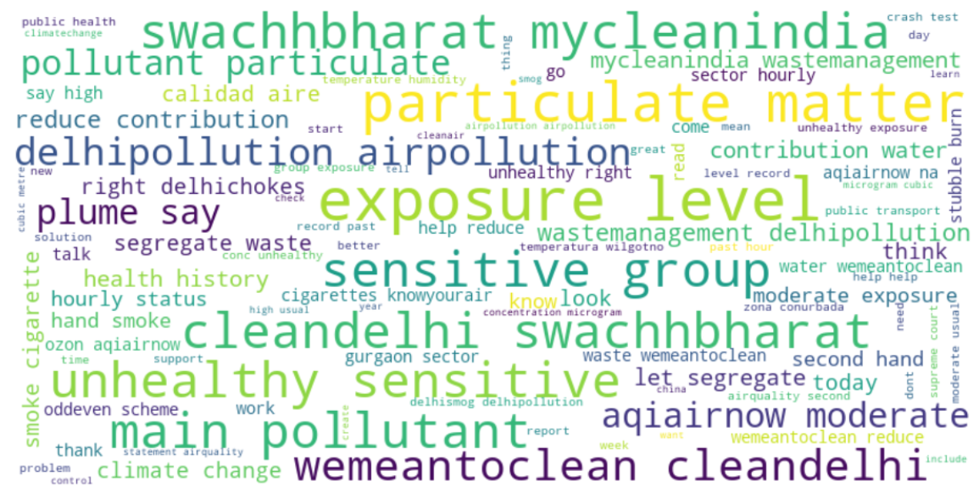
Word Cloud of Twitter Dataset
Vartalaap: What Drives #AirQuality Discussions: Politics, Pollution or Pseudo-science?

Slide 21
Word Cloud of Twitter Dataset
Vartalaap: What Drives #AirQuality Discussions: Politics, Pollution or Pseudo-science?
Notes:
Clean India Initiative initiated by the Indian Government. Cleaning is associated with garbage burning that causes air pollution.

Slide 22
Word Cloud of Twitter Dataset
Vartalaap: What Drives #AirQuality Discussions: Politics, Pollution or Pseudo-science?
Notes:
Discussion about a cricket match between India and Bangladesh which was played amind high pollution levels in Delhi in the year 2019.

Slide 23
Word Cloud of Twitter Dataset
Vartalaap: What Drives #AirQuality Discussions: Politics, Pollution or Pseudo-science?
Notes:
People correctly compare air pollution to smoking cigarette

Slide 24
Word Cloud of Twitter Dataset
Vartalaap: What Drives #AirQuality Discussions: Politics, Pollution or Pseudo-science?
Notes:
Spanish people have compared pollution in spain to pollution in New Delhi.

Slide 25
Research Question 1
What is the public perception towards air pollution mitigation strategies?
Vartalaap: What Drives #AirQuality Discussions: Politics, Pollution or Pseudo-science?

Slide 26
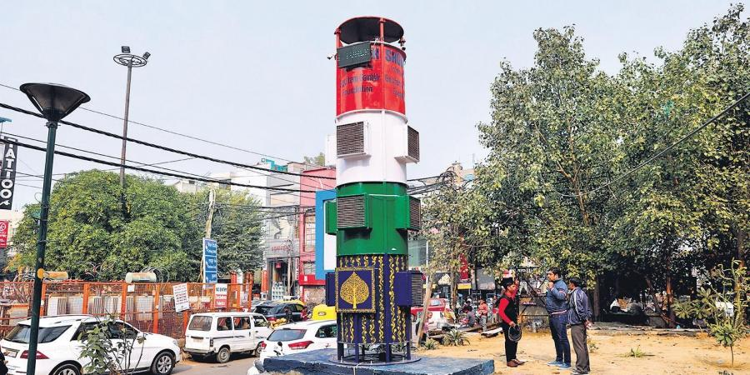
Mitigation Strategies
1. Smog Tower Installation
Vartalaap: What Drives #AirQuality Discussions: Politics, Pollution or Pseudo-science?
Notes:
Smog Towers are glorified vacuum cleaner to suck pollutants. A recent study shows that any major metropolitan city might require millions of such smog towers.

Slide 27
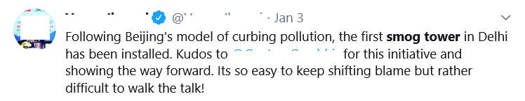
Mitigation Strategies
1. Smog Tower Installation
Vartalaap: What Drives #AirQuality Discussions: Politics, Pollution or Pseudo-science?
Notes:
Social media has a lot of positivity around smog tower.

Slide 28
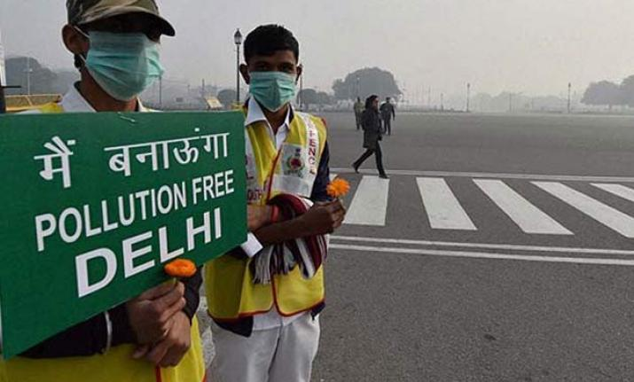
Mitigation Strategies
2. Vehicle Rationing Policy
Vartalaap: What Drives #AirQuality Discussions: Politics, Pollution or Pseudo-science?
Notes:
Smog Towers are glorified vacuum cleaner to suck pollutants. A recent study shows that any major metropolitan city might require millions of such smog towers.

Slide 29
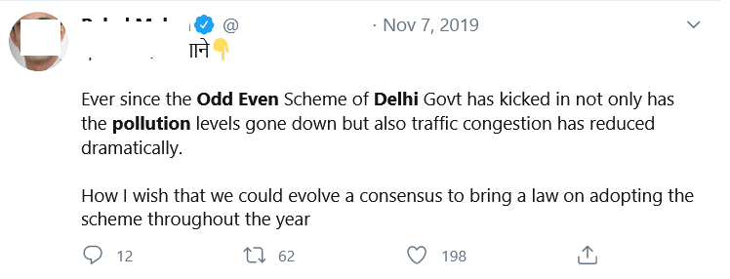
Mitigation Strategies
2. Vehicle Rationing Policy
Vartalaap: What Drives #AirQuality Discussions: Politics, Pollution or Pseudo-science?

Slide 30
Approach (Sentiments towards mitigation strategies)
In order to understand the sentiment associated with mitigation strategies, we use a language model called BERT.
The vanilla BERT is trained on Wikipedia data.
Social media data is different from wikipedia data.
It is important to contextualise the embeddings to the domain, i.e. social media
Vartalaap: What Drives #AirQuality Discussions: Politics, Pollution or Pseudo-science?

Slide 31
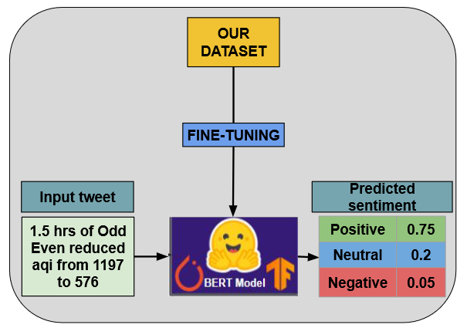
Approach (Sentiments towards mitigation strategies)
Vartalaap: What Drives #AirQuality Discussions: Politics, Pollution or Pseudo-science?

Slide 32
Evaluation
Total Tweets | “Odd-Even” | “Smog Tower”
 | 516 | 80,343
Tweets Annotated (Manual) | 516 | 1100
Vartalaap: What Drives #AirQuality Discussions: Politics, Pollution or Pseudo-science?

Slide 33
Evaluation
Total Tweets | “Odd-Even” | “Smog Tower”
 | 516 | 80,343
Tweets Annotated (Manual) | 516 | 1100
Annotated dataset was split into 5 stratified folds. We used nested cross-validation for tuning hyperparameters via grid search.
Vartalaap: What Drives #AirQuality Discussions: Politics, Pollution or Pseudo-science?

Slide 34
Evaluation
Total Tweets | “Odd-Even” | “Smog Tower”
 | 516 | 80,343
Tweets Annotated (Manual) | 516 | 1100
Annotated dataset was split into 5 stratified folds. We used nested cross-validation for tuning hyperparameters via grid search.
We select the best performing set of hyperparameters with the highest macro averaged F1 score obtained.
Vartalaap: What Drives #AirQuality Discussions: Politics, Pollution or Pseudo-science?

Slide 35
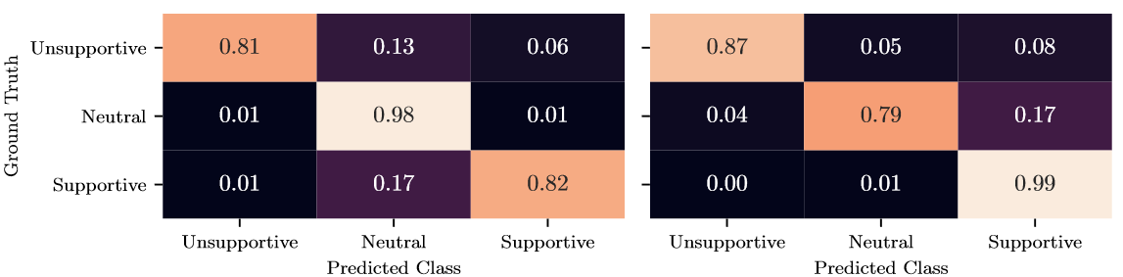
Result
Confusion matrices for untested mitigation strategies:
Odd-Even
B. Smog Tower
Vartalaap: What Drives #AirQuality Discussions: Politics, Pollution or Pseudo-science?

Slide 36
Challenge
Some tweets can contain multiple sentiments.
Tweet | Ground Truth Sentiment | Predicted Sentiment
#hatersgonnahate but our #smogtower doing its job. fabricated news about rains and wind bringing relief. Tomorrow, when weather reverses, even then smog tower will stand. #smogtowersogood that we are breathing. in your face, haters #myrighttobreathe #Saracsm | Unsupportive | Supportive
Vartalaap: What Drives #AirQuality Discussions: Politics, Pollution or Pseudo-science?

Slide 37
Challenge
Some tweets can contain multiple sentiments.
Tweet | Ground Truth Sentiment | Predicted Sentiment
#hatersgonnahate but our #smogtower doing its job. fabricated news about rains and wind bringing relief. Tomorrow, when weather reverses, even then smog tower will stand. #smogtowersogood that we are breathing. in your face, haters #myrighttobreathe #Saracsm | Unsupportive | Supportive
Wow clean Air in Delhi... Reason.. #OddEven no.. Thank you Nature for cleaning Delhi Air so that we can breath now.. @ArvindKejriwal sir please stop this odd even business and do something to stop stubble burning in adjoining states.. People will appreciate your efforts.. TYpic.twitter.com/ILtw1QQYio | Unsupportive | Supportive
Vartalaap: What Drives #AirQuality Discussions: Politics, Pollution or Pseudo-science?

Slide 38
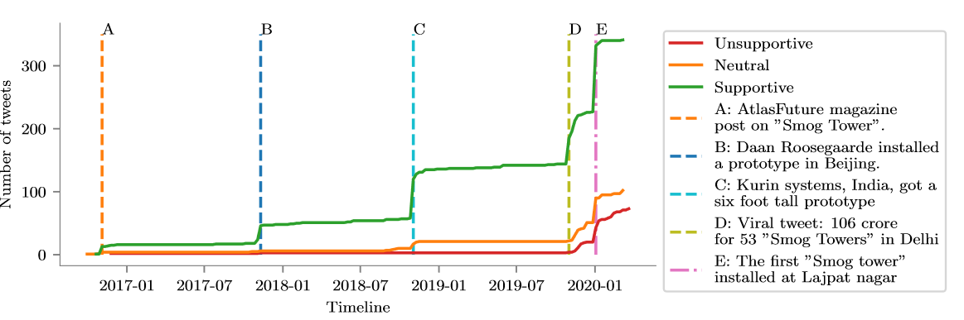
Analysis
Cumulative sum of supportive, neutral and unsupportive tweets for “Smog Tower” over time.
Vartalaap: What Drives #AirQuality Discussions: Politics, Pollution or Pseudo-science?
Notes:
WE observe that the the overall public sentiment towards untested mitigation strategies ilike smog tower installation s supportive giving a false sense of security.

Slide 39
Research Question 2
Does air pollution cause Twitter discussion?
Vartalaap: What Drives #AirQuality Discussions: Politics, Pollution or Pseudo-science?

Slide 40
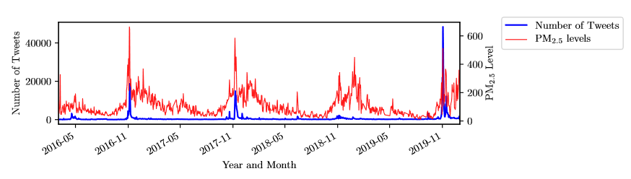
Approach
Our dataset revealed that the frequency of Tweets is high only during the winters when air pollution is high
Vartalaap: What Drives #AirQuality Discussions: Politics, Pollution or Pseudo-science?

Slide 41
Granger-Causality
We studied whether air pollution ‘Granger-causes’ Twitter discussion in terms of the raw number of tweets.
Vartalaap: What Drives #AirQuality Discussions: Politics, Pollution or Pseudo-science?

Slide 42
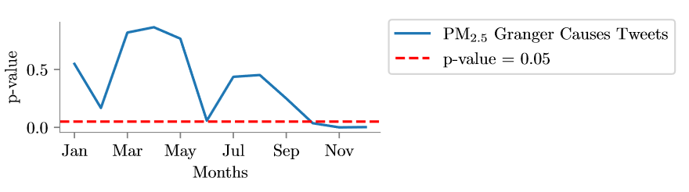
Granger-Causality
We studied whether air pollution ‘Granger-causes’ Twitter discussion in terms of the raw number of tweets.
We found out that, for most months of the year (January to September), PM_{2.5} does not ‘Granger-cause’ Twitter discussion on air pollution.
Vartalaap: What Drives #AirQuality Discussions: Politics, Pollution or Pseudo-science?

Slide 43
Granger-Causality
We studied whether air pollution ‘Granger-causes’ Twitter discussion in terms of the raw number of tweets.
During October, November and December ‘Granger-causality’ holds and it is at this time that air pollution becomes visible as smog. Consequently, the public reacts to it via social media
Vartalaap: What Drives #AirQuality Discussions: Politics, Pollution or Pseudo-science?

Slide 44
Granger-Causality
We studied whether air pollution ‘Granger-causes’ Twitter discussion in terms of the raw number of tweets.
World Environment Day
Vartalaap: What Drives #AirQuality Discussions: Politics, Pollution or Pseudo-science?
Notes:
We found that the volume of tweets on air pollution increases abruptly on June 5th 2016, i.e. World Environment Day, and that is the same period when ‘Granger-causality’ approaches the significance level between May and July.

Slide 45
Research Question 3
What are the air pollution topics discussed?
Vartalaap: What Drives #AirQuality Discussions: Politics, Pollution or Pseudo-science?

Slide 46
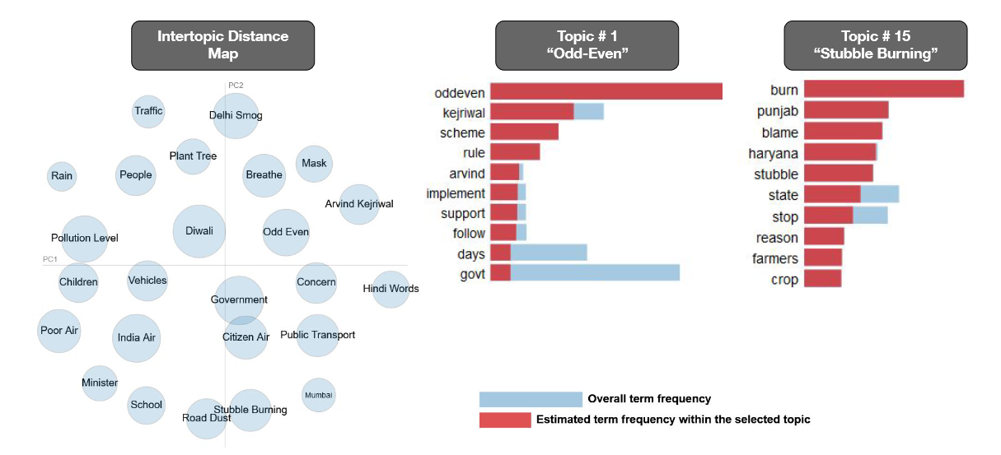
Topic Modeling
Vartalaap: What Drives #AirQuality Discussions: Politics, Pollution or Pseudo-science?

Slide 47
Topic Modeling
Vartalaap: What Drives #AirQuality Discussions: Politics, Pollution or Pseudo-science?

Slide 48
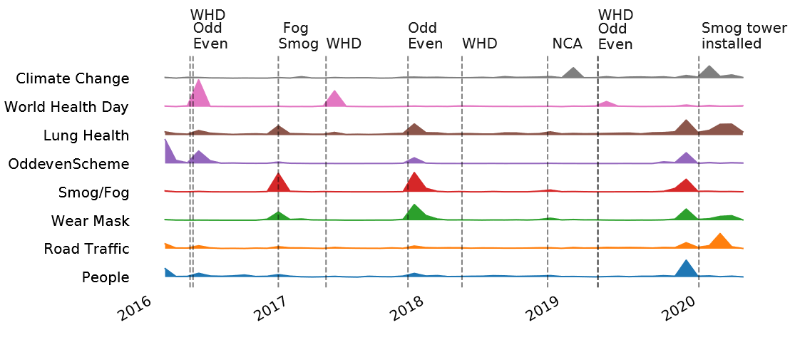
Topic Modeling
Vartalaap: What Drives #AirQuality Discussions: Politics, Pollution or Pseudo-science?

Slide 49
Summary
We saw that public perception of untested mitigation strategies is positive which is unfortunate.
While air pollution is a year long problem, twitter discussions are not.
Discussions on most of the topics are short lived.
Vartalaap: What Drives #AirQuality Discussions: Politics, Pollution or Pseudo-science?

